Slide 1


Windows built-in Sandbox Disables Microsoft Defender and other EDR/AVs:
Attack Detection and Prevention via MemoryRanger
Denis Pogonin
Igor Korkin
2022

Slide 2


WHO WE ARE
Denis Pogonin
Bachelor of Information Security
National Research Nuclear University MEPhI
Cryptology and Cybersecurity Department
Igor Korkin, PhD
Independent Security Researcher
Speaker at CDFSL, BlackHat, HITB, SADFE, ROOTCON, Texas Cyber Summit
sites.google.com/site/igorkorkin

Slide 3

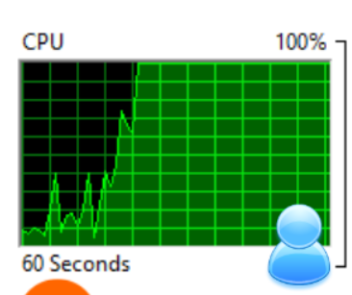


Different Malware have Different Goals
BANK
Pay to unlock the PC!
Gain full remote access
Perform mining
Encrypt\wipe files
Packing, encryption and obfuscation
Disable or evade Microsoft Defender

Slide 4
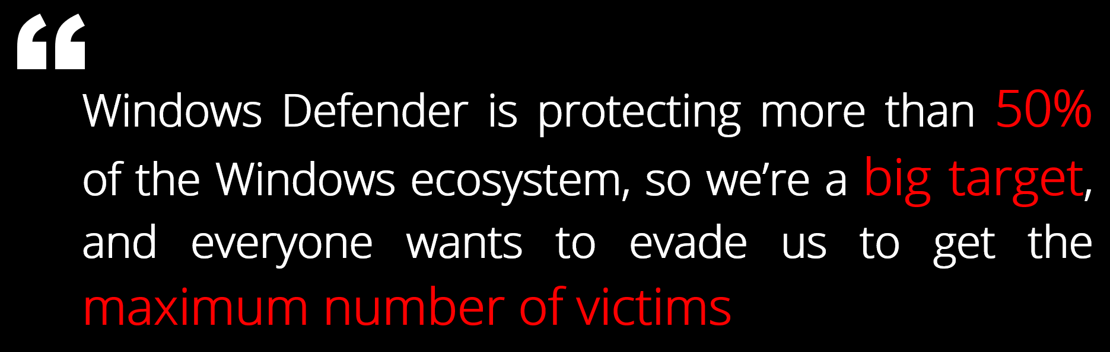

Microsoft Defender is running on over 500 000 000 PCs
Microsoft Defender is protecting more than 50% of the Windows ecosystem, so we’re a big target, and everyone wants to evade us to get the maximum number of victims
Tanmay Ganacharya
Partner Director for Security Research
@ Microsoft Defender for Endpoint
* Top Microsoft Defender expert: These are the threats security hasn't yet solved, ZDNet, 2019
https://www.zdnet.com/article/top-windows-defender-expert-these-are-the-threats-security-hasnt-yet-solved

Slide 5

Attack Vectors on Microsoft Defender

Slide 6
Thread modeling Microsoft Defender

Slide 7
User-mode Attacks: 1, 2
2
Attacks via internals techniques
Packing, Obfuscation, Encryption, | FuckThatPacker
Token Impersonation: Abusing TrustedInstaller to stop MD | DefenderSwitch, T1, DefenderStop
Custom loader bypass kernel callbacks | DarkLoadLibrary
1
Attacks via Windows Built-in and Whitelist Apps
PowerShell Reflection | PowerShellRunner, P1, P2
Herpaderping | H1
Code Injection into the whitelisted apps | I1, UltimateWDACBypassList
LockBit Ransomware abuse Windows Defender command line to load payload, L1 Microsoft published a list of built-in apps that can be abused to bypass Windows Defender, M1

Slide 8
User-mode Attacks: 3, 4, 5
5
User-mode Sandboxing
Use syscalls to modify Token structure: Token Integrity Level Token Privileges | SandboxDefender, PPLGuard (‘trust label’)
→Fixed at June, 2022 | KillDefender_BOF
4
Abuse Symbolic links
Unload WdFilter via abusing NT symbolic links redirection | unDefender
3
Modify Microsoft Defender settings
PowerShell cmdlets | Stop scanning and other security features Add exclusion path Block attaching to newly created volumes | TrickBot Trojan, Zloader Trojan, MosaicLoader, Kraken Botnet, P1, P2
WMI |  | DeroHE ransomware (n.b. wmic.exe is deprecated now)
Group Policy |  | Egregor ransomware, Defender Control
Registry values | Block attaching to volumes | R1

Slide 9
Kernel-mode Attacks
6
Attacks on Token structure
Clear PPL to terminate WD apps | P1, P2, P3
Kernel-mode Sandboxing via patching token structure: Token Integrity Level Token Privileges | A newly proposed idea
8
Attacks on ETW structures
7
Disable Various Kernel Callbacks
Patching various ETW structures | ETW1
Process, Thread, Image Callbacks Registry Callbacks Objects Callbacks Minifilter Callbacks Windows Filtering Platform Callouts ETW Callbacks | CheekyBlinder, C1, C2, C3, C4, Lazarus Group's Rootkit Attack

Slide 10

Microsoft Defender: components

Slide 11
Microsoft Defender: about 10 apps + 6 drivers
User-mode Processes and Services
MsMpEng
WinDefend
MsSense
NisSrv.exe
WdNisSvc
MsMpEngCP
MpCopyAccelerator
SecurityHealthService
WSCSVC
MPSSVC
Kernel-mode Drivers
WdFilter (file-filter)
WdDevFlt (device-filter)
MpsDrv (firewall)
WdBoot (ELAM)
WdNisDrv (NDIS WFP)
MpKSLDrv (update)
• %ProgramData%\Microsoft\Microsoft Defender\Platform
• %Windir%\System32\drivers\wd

Slide 12
Microsoft Defender is inspecting disk and memory content

Slide 13
MpEngine.dll: Microsoft Malware Protection Engine
MpEngine.dll is the core of AV detection with 45,000+ functions

Slide 14
Microsoft Defender detects malware in files and memory

Slide 15
Attackers want to block inspections of both files and apps
0) Disable Microsoft Defender

Slide 18
Step1: Attackers want to block files inspection

Slide 19
Microsoft Defender Opens a file to inspect it

Slide 20
Microsoft Defender Opens a file to inspect it

Slide 21
Microsoft Defender Opens a file to inspect it

Slide 22
Microsoft Defender Opens a file to inspect it

Slide 23
Microsoft Defender Opens a file to inspect it

Slide 24
Microsoft Defender Opens a file to inspect it

Slide 25
Microsoft Defender Opens a file to inspect it

Slide 26
Microsoft Defender Opens a file to inspect it

Slide 27
Microsoft Defender Opens a file to inspect it

Slide 28
Microsoft Defender Opens a file to inspect it

Slide 29
Patching the Integrity Level can block opening a file

Slide 30



Slide 31



Step 1.1 Integrity Levels: INTRO

Slide 32
MIC: Integrity Levels

Slide 33


MIC: Integrity Levels

Slide 34


MIC: Integrity Levels

Slide 35

MIC: Integrity Levels

Slide 36

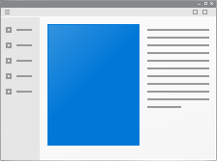
MIC: Integrity Levels

Slide 37
MIC: Integrity Levels
$$if \left({Level}_{APP}≥{Level}_{FILE}\right)→access allowed$$
$$else →access denied$$

Slide 38
MIC: Integrity Levels
Let’s lower Integrity level for !
$$if \left({Level}_{APP}≥{Level}_{FILE}\right)→access allowed$$
$$else →access denied$$

Slide 39

How Integrity levels are stored in memory?
Step 1.2 Integrity Levels: DATA

Slide 40
Integrity Level: Token and Index
Apps
Token structures

Slide 41
Integrity Level: Token and Index
Apps
Token structures

Slide 42
Integrity Level: Token and Index
TOKEN structure
SID_AND_ATTRIBUTES * UserAndGroups
Apps
SID_AND_ATTRIBUTES
Token structures

Slide 43
Integrity Level: Token and Index
TOKEN structure
SID_AND_ATTRIBUTES * UserAndGroups
Apps
ULONG IntegrityLevelIndex
SID_AND_ATTRIBUTES
SID_AND_ATTRIBUTES
Token structures
ULONG Attributes
VOID* Sid

Slide 44

How IntegrityLevelIndex is used during Access Check?
Step 1.3 Integrity Levels: CODE

Slide 45
MIC: Check Integrity Level
Windows Defender
Open a file on the disk
file

Slide 46
MIC: Check Integrity Level
Windows Defender
Open a file on the disk
file
ntdll
NtOpenFile
NtCreateFile

Slide 47
MIC: Check Integrity Level
Windows Defender
Open a file on the disk
file
ntdll
NtOpenFile
NtCreateFile
nt
NtOpenFile
NtCreateFile
IopCreateFile
ObOpenObjectByNameEx
SeAccessCheck
SeAccessCheckWithHint
SepMandatoryIntegrityCheck

Slide 48
MIC: Check Integrity Level
Windows Defender
Open a file on the disk
file
ntdll
NtOpenFile
NtCreateFile
nt
NtOpenFile
NtCreateFile
IopCreateFile
ObOpenObjectByNameEx
SeAccessCheck
SeAccessCheckWithHint
SepMandatoryIntegrityCheck

Slide 49
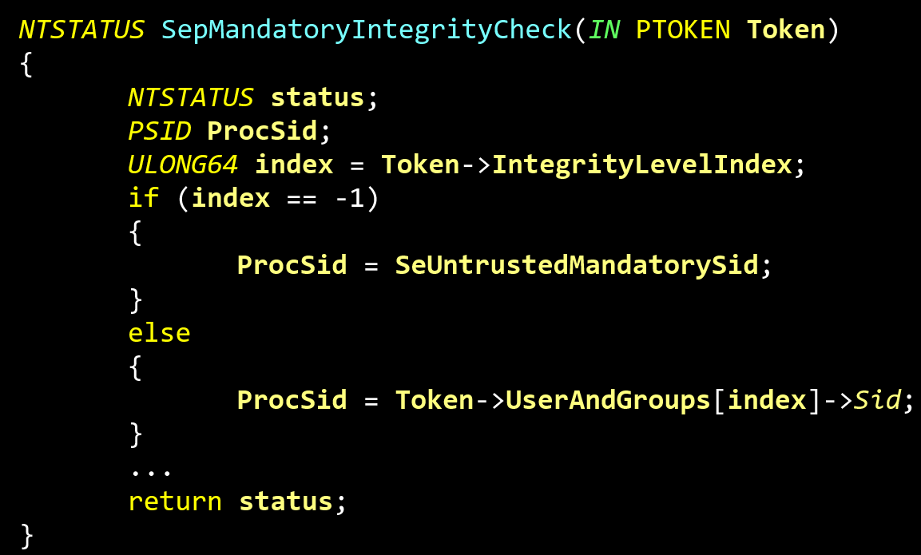

Slide 53

Patching IntegrityLevelIndex blocks files inspection
Step 1.4 Integrity Levels: Attack

Slide 54
Attackers lower Integrity Level for Microsoft Defender

Slide 55
Attackers check that Microsoft Defender is ON via executing a malware from a password-protected archive

Slide 56
Attackers check that Microsoft Defender is ON via executing a malware from a password-protected archive

Slide 57
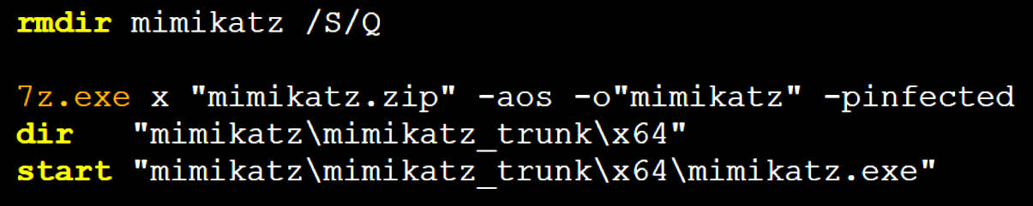
Attackers check that Microsoft Defender is ON via executing a malware from a password-protected archive
clear_extract_and_check.bat:

Slide 58
Attack on MIC: DEMO
The online version is here – https://www.youtube.com/embed/AJV4UVaw8kg?vq=hd1440

Slide 59


0) Disable Microsoft Defender

Slide 60
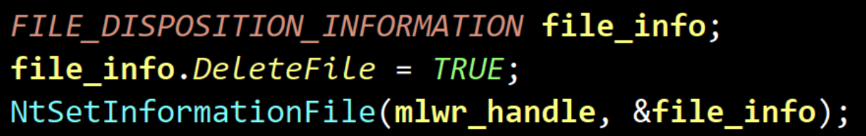
Summary
Microsoft Defender app removes malware files via call:
CMD fails to launch mimikatz with STATUS_VIRUS_INFECTED (0xC0000906) that is returned to block launching a malware app

Slide 61
Summary
Microsoft Defender app removes malware files via call:
CMD fails to launch mimikatz with STATUS_VIRUS_INFECTED (0xC0000906) that is returned to block launching a malware app
Which driver returns this status?

Slide 62
Microsoft Defender Antivirus Mini-Filter Driver (WdFilter)
It register a mini-filter via FltRegisterFilter()
It prevents launching a malware app via post-create callback

Slide 63
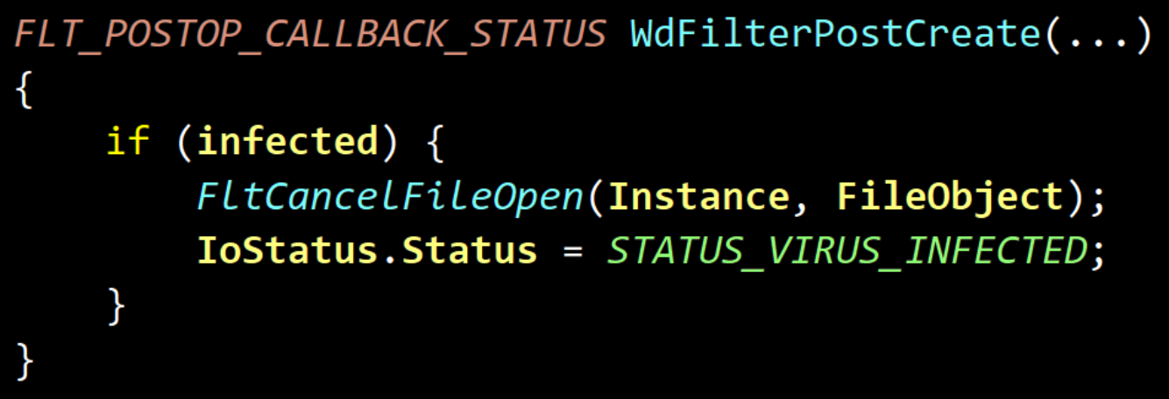
Microsoft Defender Antivirus Mini-Filter Driver (WdFilter)
It register a mini-filter via FltRegisterFilter()
It prevents launching a malware app via post-create callback

Slide 64
Microsoft Defender Antivirus Mini-Filter Driver (WdFilter)
It register a mini-filter via FltRegisterFilter()
It prevents launching a malware app via post-create callback
Defender is still able to access apps memory. But how?

Slide 65
Step2: Attackers want to block apps memory inspection

Slide 66
Defender opens a process

Slide 67
Defender opens a process

Slide 68
Defender opens a process

Slide 69
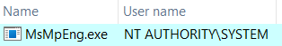
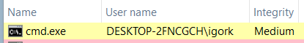
DEBUG PRIVILEGE ALLOWS TO GET FULL ACCESS TO ALL APPS
Microsoft Defender has a SeDebugPrivilege privilege to open apps owned by another account

Slide 70
Defender opens a process

Slide 71
Patching Privileges can block opening an APP

Slide 72
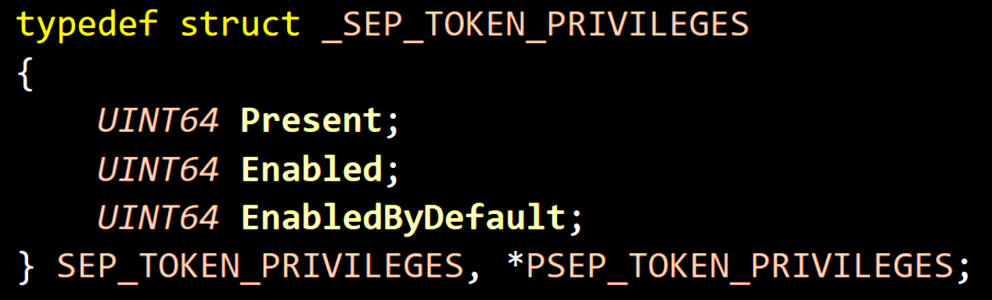
TOKEN Privileges
Experiments:
revoking SeDebugPrivilege-bit from the field named Enabled
prevents Microsoft Defender from inspecting apps memory.

Slide 73

Attackers can disable Microsoft Defender completely!!

Slide 74
Attackers patch two values: Integrity Level Index and Privilege

Slide 75
DEMO: Attack on MIC + Token Privilege
The online version is here – https://www.youtube.com/embed/ihhUUd9qJTY?vq=hd1440

Slide 76
Microsoft defender is completely disabled
0) Disable Microsoft Defender

Slide 77

Kernel-mode attack has disabled Microsoft Defender without triggering any security reaction

Slide 79

The attack has blinded Microsoft Defender. What about other AVs?

Slide 80














Kernel-mode Sandboxing attack blinds top AVs
AV Name | AV ability to detect malicious files | AV ability to detect malicious processes
Microsoft Defender | Disabled
McAfee
Malwarebytes
Avast
AVG
Kaspersky | Disabled | Enabled
 | Enabled, but AV cannot remove malware files | Disabled
Disclaimer: The purpose is to provide technical review only. This analysis is not designed to promote any solutions.
We do respect all antiviruses and endpoint security solutions.

Slide 81
Disabling AVG AntiVirus from Denis
Disclaimer: The purpose is to provide technical review only. This analysis is not designed to promote any solutions.
We do respect all antiviruses and endpoint security solutions.

Slide 82

MemoryRanger Defends Microsoft Defender

Slide 83
MemoryRanger: Intro

Slide 84
MemoryRanger: Intro

Slide 85
MemoryRanger: Intro

Slide 86
MemoryRanger: Intro

Slide 87
MemoryRanger: Intro

Slide 88
MemoryRanger: Intro

Slide 89
MemoryRanger: Features
Components:
user-mode control app
kernel-mode driver to register OS callbacks
hypervisor based dispatcher based on Intel VT-x and EPT technologies
The key features:
Runs kernel-mode drivers into isolated memory enclaves
Allows different memory access configuration for each memory enclave
Number of enclaves can be increased in runtime (while VBS has fixed 2 enclaves only)
Technical features:
Hooks kernel API routines
Redirects illegal access to the sensitive data to the fake content
Supports newest Windows 11 x64 and it is open-source
github.com/IgorKorkin/MemoryRanger

Slide 90






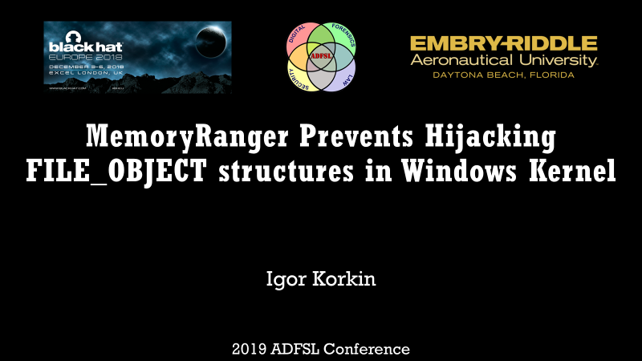

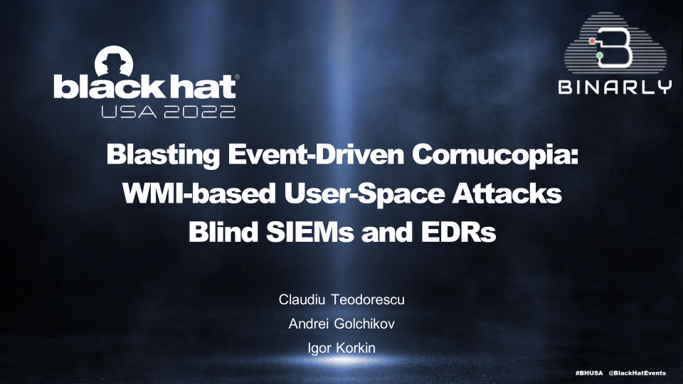
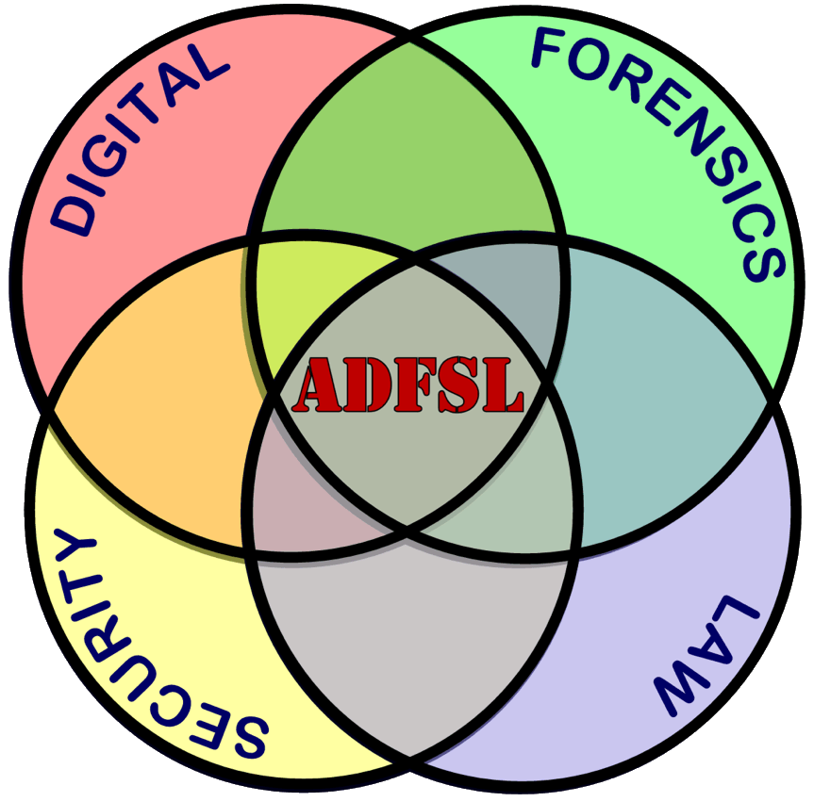
MemoryRanger was in US, UK, and Asia and triple at BlackHat
2018
2019
2020
2021
2022

Slide 91
MemoryRanger Customization protects Microsoft Defender

Slide 92
MemoryRanger Customization protects Microsoft Defender

Slide 93
Demo: MemoryRanger Defends Microsoft Defender
The online version is here – https://www.youtube.com/embed/Ohqhq50wVjI?vq=hd1440

Slide 94
94

Slide 100

MemoryRanger requires the hardware virtualization support.
How to protect PCs without using hypervisor?

Slide 101
The Part of Denis

Slide 102
ProcessTokenMonitor overview

Slide 103
If the computer doesn't support hardware virtualization, what can I use for a defense?

Slide 104

ProcessTokenMonitor Detects tHe ATTACk

Slide 105
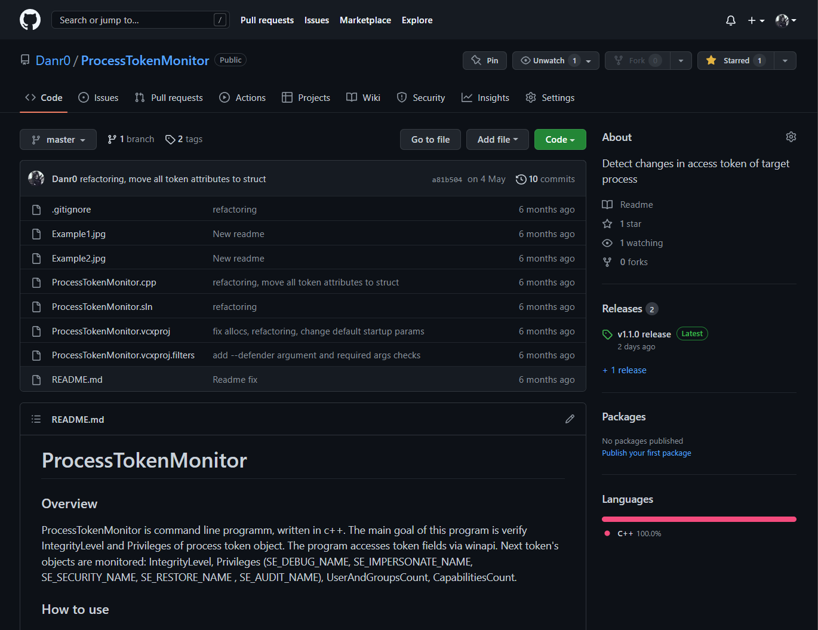
ProcessTokenMonitor
GitHub: https://github.com/Danr0/ProcessTokenMonitor

Slide 106
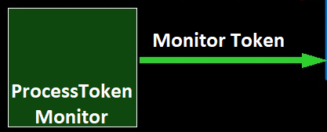

Program monitors the process token

Slide 107
Monitored attributes of token
IntegrityLevel
Privileges
UserAndGroups
Process Token
Capabilities

Slide 108
algorithm scheme
Start
If target process is Windows Defender
No
Yes
Using standard Defender’s token attributes
Get current token attributes
Verify current process attributes against saved
If token attributes is changed
No
Yes
Print alert message
End

Slide 109
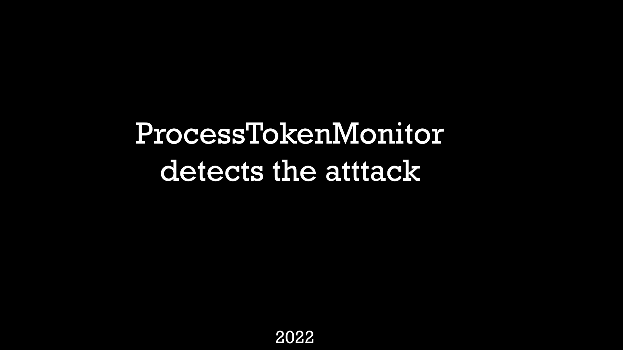
ProcessTokenMonitor DEmo

Slide 110
Conclusion
Kernel-mode threats are very dangerous even for Windows 11 x64
The global malware trend is to bypass or disable security products without terminating the AV/EDR apps
Microsoft Defender is the most desired goal for attackers
Mandatory Integrity Control (MIC) is designed to sandbox untrusted apps, but attackers can abuse MIC to sandbox Microsoft Defender and other AVs
MemoryRanger can block attacks on kernel data including attacks on MIC
ProcessTokenMonitor can reveal the presented kernel sandboxing attack.

Slide 111




Thank you!
Igor Korkin | igor.korkin@gmail.com
Denis Pogonin | denpog00@gmail.com
All the details are here | igorkorkin.blogspot.com
Notes:
Thank you!

Slide 113
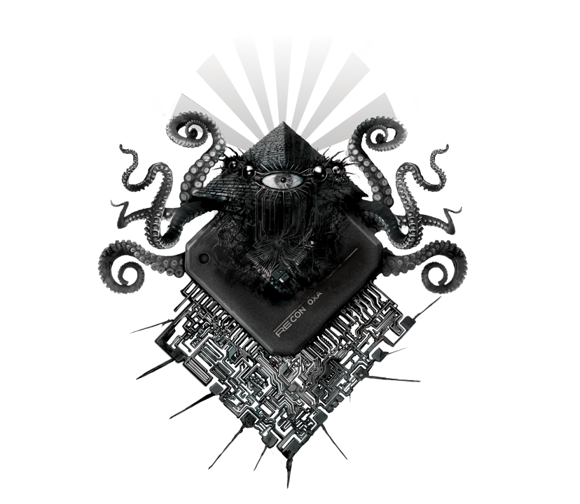






Memory Ranger’s Evolution
MemoryRanger
with a new feature
Prevention of the
FILE_OBJECT Hijacking
MemoryRanger with a data-only enclave
Prevention of
Handle Hijacking
Hijacking NTFS
Token Hijacking
MemoryRanger
against Mimikatz
Prevention of
illegally disabling PPL for LSASS
MemoryRanger:
PPL and Win11
Prevention of
PPL disabling for system apps
PPL enabling for malware apps
MemoryRanger:
ETW and Win11
Prevention of
attacks on ETW sessions of Windows Defender
MemoryRanger:
WMI and Win11
Prevention of
attacks on WMI
MemoryRanger:
AVs and Win11
Prevention of
Sandboxing Microsoft Defender
MemoryRanger
AllMemPro
AllMemPro
MemoryMonRWX
MemoryMonRWX
MemoryMonRWX
HyperPlatform
HyperPlatform
HyperPlatform
HyperPlatform
Step 1
Step 2
Step 3
Step 4
Step 5
Step 6
Step 7.1
Step 7.2
Step 8
Step 9
Step 10
REcon
Korkin, I., & Tanda, S. (2016). Monitoring & controlling kernel-mode events by HyperPlatform. Recon, Canada.
Korkin, I., & Tanda, S. (2017). Detect Kernel-Mode Rootkits via Real Time Logging & Controlling Memory Access. ADFSL, USA.
Korkin, I. (2018). Hypervisor-Based Active Data Protection for Integrity and Confidentiality of Dynamically Allocated Memory in Windows Kernel. ADFSL, USA.
Korkin, I. (2018). Divide et Impera: MemoryRanger Runs Drivers in Isolated Kernel Spaces. BlackHat, UK
Korkin, I. (2019). MemoryRanger Prevents Hijacking FILE_OBJECT structures in Windows Kernel. ADFSL, USA.
Korkin, I. (2020). Kernel Hijacking is Not an Option: MemoryRanger Comes to the Rescue Again
Korkin, I. (2021). Protected Process Light is not Protected: MemoryRanger Fills The Gap Again
RootCON 2022

